Slide 1
SEND at Wickhambreaux School
Love
Trust
Community

Slide 2

Notes:
1- Insert picture >> Format >> Send to back
2- Add quote >> Add Author/Writer >> Adjust text to suit image

Slide 3
Contents
Wickhambreaux School’s Vision
What is SEND?
SEND True or False?
Inclusion at Wickhambreaux
Universal Offer
Targeted Offer
Bespoke Offer
Ms Redmond

Slide 4

Wickhambreaux School’s Vision
Our small, rural school opens its door to a diverse global family offering a warm welcome. We invest in, and nurture, everyone’s unique, God given talents and abilities. Our dynamic, enriched, curriculum provides individuals with a supportive community where they can reflect and thrive, developing a deeper understanding of the world.

Slide 5

What is SEND?

Slide 6
What is SEND?
(Special Educational Needs and Disabilities)
Needs and/or disabilities which can affect a child or young person’s ability to learn. They can affect their:
  behaviour or ability to socialise, for example they struggle to make friends
  reading and writing, for example because they have dyslexia
  ability to understand things
  concentration levels, for example because they have attention deficit hyperactivity disorder (ADHD)
  physical ability

Slide 7
What is SEND?
Areas of need are grouped into the following categories of need:
  Communication and interaction
    Autism or characteristics or aspects of autism spectrum
    Speech, language and communication
  Cognition and learning
  Social, emotional and mental health difficulties
  Sensory and/or physical needs
    Physical disability
    Hearing Impairment
    Visual impairment
    Multi-sensory impairment

Slide 8

SEND True or False?

Slide 9
SEND True or False?
A diagnosis is needed to access support?

Slide 10
SEND True or False?
A diagnosis is needed for support?
FALSE – you do not need a diagnosis for your child to receive support. Support is available to all children who need it.

Slide 11
SEND True or False?
My child has a diagnosis; therefore, they need an EHCP (Education, Health and Care Plan)

Slide 12
SEND True or False?
My child has a diagnosis; therefore, they need an EHCP (Education, Health and Care Plan)
FALSE – An EHCP is for children who need more support than is available through special educational needs support.

Slide 13
SEND True or False?
If my child is receiving support, they’re automatically added to the SEND register?

Slide 14
SEND True or False?
If my child is receiving support, they’re automatically added to the SEND register?
FALSE – Most children will receive additional support at some point during their educational journey, this could be a one-term intervention for a specific gap in knowledge, friendship support etc. In which case, their need will be monitored and progress recorded.

Slide 15
SEND True or False?
My child is not taken out of class for support or interventions, so they’re not receiving what they need

Slide 16
SEND True or False?
My child is not taken out of class for support or interventions, so they’re not receiving what they need
FALSE – Where possible we aim to support your child in class.

Slide 17

Inclusion at Wickhambreaux

Slide 18

What is Inclusion?

Slide 19
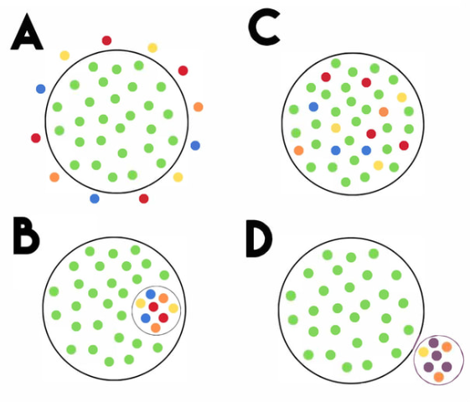
Segregation, Exclusion, Integration or Inclusion?

Slide 20
Exclusion
Inclusion
Integration
Segregation

Slide 21
Universal Offer
As part of the “Mainstream Core Standards” the school has put together a universal offer.
It outlines some of the practices and adaptations that are part and parcel of Quality First Teaching (QFT): the inclusion of all pupils in high-quality everyday personalised teaching.
The provision and strategies outlined in this section may be required for children and young people with SEN and/or disabilities but will undoubtedly be of benefit to many of the learners in the school.

Slide 22
Targeted Offer
Some learners with SEND will require more support than most of their peers. This support will be provided in addition to the universal offer.
We provide this support mainly using our own resources but also via the Local Inclusion Forum Team resource, Health and/or Social Care services.
Usually, when a learner is receiving this additional support, they will have an identified special educational need or disability or be presenting with characteristics that fall under one of the four broad areas of need set out in SEND Code of Practice 2015. The four broad areas of need are:
  Communication and interaction
  Cognition and learning
  Social, emotional and mental health difficulties
  Sensory and/or physical needs.
https://www.kent.gov.uk/education-and-children/special-educational-needs

Slide 23
Targeted Offer
Pupils who we think need a targeted offer are identified and regularly reviewed via the Assess, Plan, Do, Review cycle.
Usually, after 3 cycles of assess, plan, do, review and no progress is made, then we look to more bespoke interventions. However, a bespoke offer may be implemented before 3 cycles, if necessary.

Slide 24
Bespoke Offer
If your child requires further support beyond the universal and targeted interventions, a bespoke provision will be provided.
This could involve external services such as speech and language therapy, occupational health, counselling etc.
This will usually (but not always) involve interventions which take your child out of class, we try to stagger this so they don’t miss the same lessons each time.

Slide 25
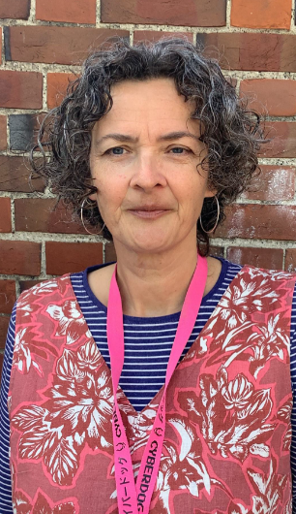
Ms Redmond
Ms Redmond organises and implements many interventions for the school
Benchmarking and diagnostic information
Phonics interventions
BRP – Better Reading Partnership
Specialised Literacy lessons
Inference and deduction groups
Writing interventions

Slide 26

If you are always trying to be normal, you will never know how
AMAZING you can be.
Maya Angelou – American Poet

